Slide 1
Agenda
1
Public preview content overview & demo
2
Near future investments
3
Feedback and Q&A
Notes:
Super existed to be here today -> biggest integration -> personally start 2 years ago -> how 2 integrate these 2 SaaS services bringing you the full Power … -> after 2 year we launched on Monday -> you can all start taking advantage of Power Apps ALM with Power BI today! Let get started!
How many: know what ALM is ? How many used Solutions? Trying to embed a Power BI report seeing it break on deployment between environments? Trying to embed a report in a form and pass context to it?

Slide 2
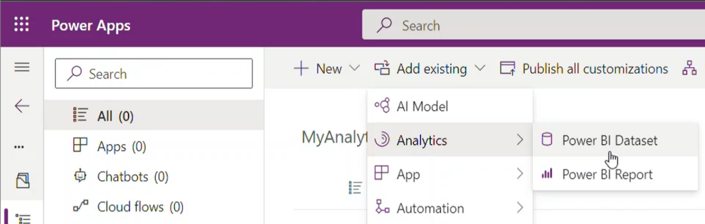
Key capabilities
Add to Dataverse and solutions
One click deployment
Customization
Power BI content can be embedded and included in a Power App solution package
Importing a Power Apps Solution deploys content to dedicated environment workspace in Power BI
Customize Power BI content with ease to fit the organization/department analytics needs
Notes:
3 Major capabilities for this integration:
Add Power BI Report and datasets just like any other component in dataverse. You can add Power BI report and dataset you have access to.
We learned that environment admins have many solutions to take care of, importing a solution will automatically deploy Power BI artifacts to a dedicated workspace connected to the right environment!
We have stopped there! The close integration with Power apps solutions framework will enable you to customize managed solution and export them as additional layer allowing you to customize managed solutions from your IT department or AppSource.

Slide 3
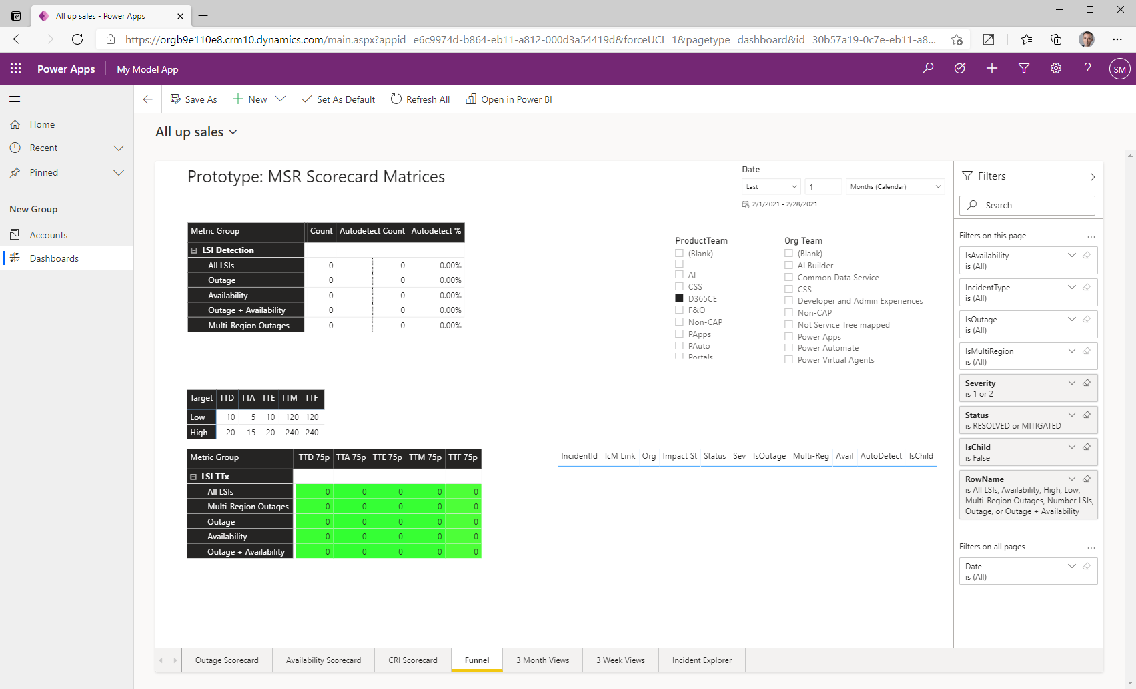
Problem today
A model-driven app can only have URL-referenced Power BI report or dashboard embedded, with no ALM support for embedded Power BI components.
Makers must edit an XML file to embed Power BI components on a form.
Power BI embedded dashboard
Power BI workspace
Power BI report
Model-driven app
Power BI embedded dashboard
Notes:
Why it matter to you?
Until today it wasn’t possible to include Power BI artifacts in a solution which resulted in application breaking on deployment between tenants or environment because of this many chose not to embed analytics inside their Power Apps

Slide 4
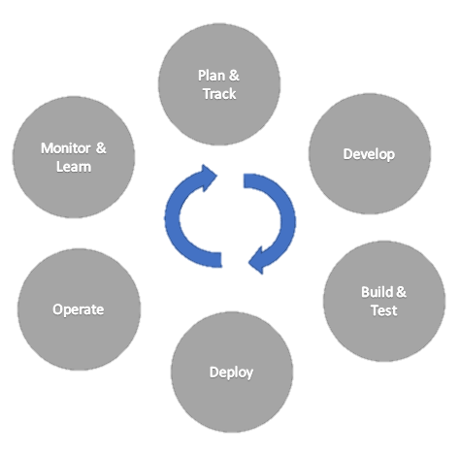
Power Apps Solutions
ALM is the lifecycle management of applications, which includes governance, development, and maintenance.
Application
life cycle

Slide 5

Problem today
Static links are maintained across import/export
Same report referenced by multiple Dataverse environments
Does not support cross-tenant solution install, as link will be broken
Tenant
Tenant
Workspace
Dataverse
Dataverse
Dataverse
Solution

Slide 6

Problem today
Static links are maintained across import/export
Same report referenced by multiple Dataverse environments
Does not support cross-tenant solution install, as link will be broken
Tenant
Tenant
Workspace
Dataverse
Dataverse
Dataverse
Solution
Solution
Solution

Slide 7
Add to Dataverse
Power BI reports & dataset from app.powerbi.com can be added to Dataverse environments.
Maker must have write permission to the shared Power BI workspace.
Tenant
PBI shared workspace
Report/Dataset
Notes:
You begin the work by uploading a report and dataset to Power BI service to a shared workspace or any workspace you have write permission.
Soon to support ‘My Workspace’ – for now we need a shared workspace. Some orgs can’t create shared workspaces so get stuck.
First created when we do a solution operation on PBI (need workspace create perm in PBI) – can fail here with a message.

Slide 8
Add to Dataverse
Add “From Power BI” will export the content into Dataverse.
The Dataverse component includes a payload of the content.
Tenant
PBI shared workspace
Report/Dataset
Dataverse environment
component
Export
Notes:
Once you select to add existing Power BI report/dataset you will be prompted to select “from Dataverse” or “From Power BI”. If you already created Power BI components, they will show up “from Dataverse”. When you add “from Power BI” the report and dataset are imported into Dataverse.

Slide 9
Add to Dataverse
1:1 Mapping workspace to environment.
Dataverse provisions the environment workspace and artifacts on demand.
Solution operations (CRUD) apply on Power BI artifacts.
Tenant
PBI environment workspace
PBI shared workspace
Report/Dataset
Report/Dataset
Dataverse environment
component
Notes:
As you add the Power BI to Dataverse, in case an environment workspace isn’t already created a dedicated Power BI workspace will be created and the report & dataset will be imported to this dedicated workspace. We also developed permission sync which will give permission to perform operation on the workspace to users that have the appropriate roles in the Dataverse environment.

Slide 10
Deploy across environments
Exporting solution as managed or unmanaged includes Power BI content.
Dataverse provisions the workspace and artifacts in dedicated environment workspace.
Tenant
PBI environment workspace
PBI environment workspace
Report/Dataset
Report/Dataset
Dataverse environment
Dataverse environment
component
component
Solution.zip
Notes:
Now any ISV can now release apps on app source that include Power BI as the content is part of the solution ZIP

Slide 11
Deploy across tenants
Exporting solution as managed or unmanaged includes Power BI content.
Dataverse provisions the workspace and artifacts in dedicated environment workspace.
Tenant
Tenant
PBI environment workspace
PBI environment workspace
PBI environment workspace
Report/Dataset
Report/Dataset
Report/Dataset
Dataverse environment
Dataverse environment
Dataverse environment
component
component
component
Solution.zip
Notes:
Dataverse and the dedicated Power BI workspace can be synced – and if for example you make changed to a managed component removing unmanaged customization will revert the Power BI report/dataset back to the managed version.

Slide 12
Demo – Create
Add Power BI report & Dataset to a Power App Solution
Sample Sales Hub customization

Slide 13

Control connectivity of Power BI reports/ dataset from Power Apps
Dataverse data source: easily change data source by using the dataset component settings. No dataset parametrization required!
Power BI parameterized data sources: can be configured via “Edit parameters” and can reference:
Environment domain
Environment variable
Custom text
PBI environment Workspace
Report
Dataset
parameter
Dataverse environment
Report
Dataset
parameter
Env. var
Notes:
Let’s recap: for each Dataverse environment

Slide 14
Pro tips
Solution with Power BI content can be used with Azure DevOps, VSCode extensions, etc. to achieve configuration management
Power BI content which participates is part of an app should be managed with Power Apps Solution to achieve healthy ALM process and flexibility on deployment across environments or Tenants
Power BI System Solutions points to connected Power BI workspace
Don’t delete the created Power BI workspace to avoid re-import of solutions

Slide 15
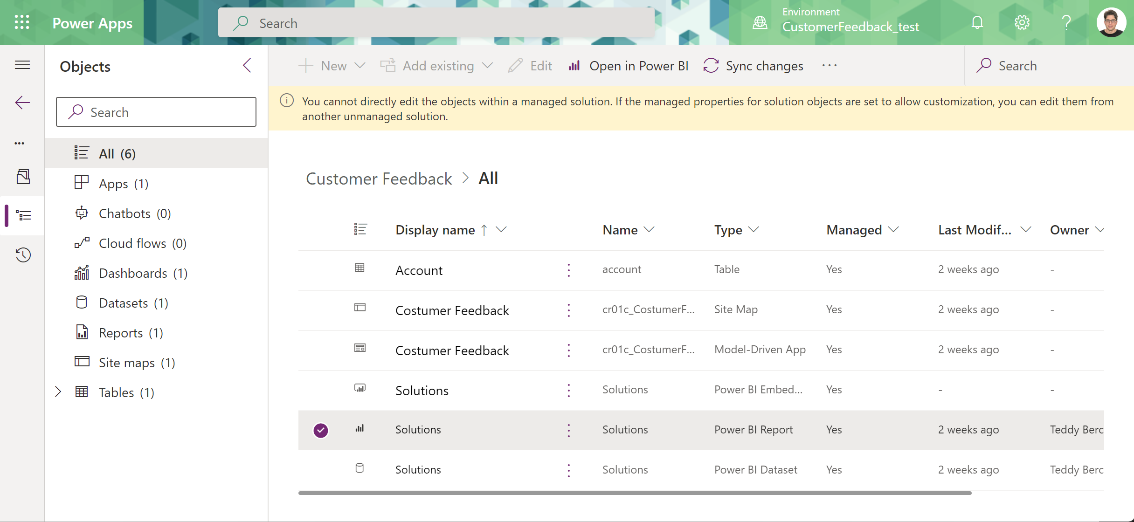
Additional solutions operations
Solution update/stage for upgrade/upgrade are supported.
Artifacts are being updated according to Power Apps component in Dataverse.
Solution layering is supported on an artifact level:
Making changes to a managed report/dataset can be discarded (“Remove unmanaged layer”).
Add additional reports and datasets to a managed solution to enhance it across departments.
Add analytics to first-party solutions.
Notes:
Add documentation link: “This is a complex…”

Slide 16
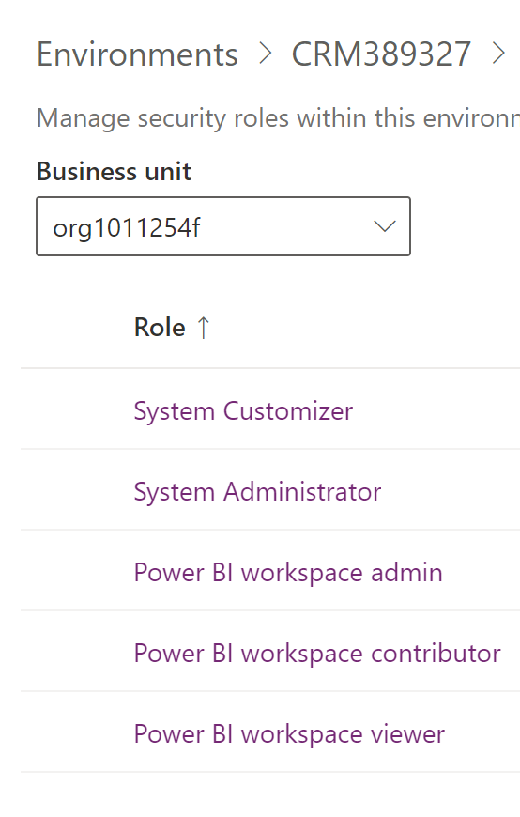
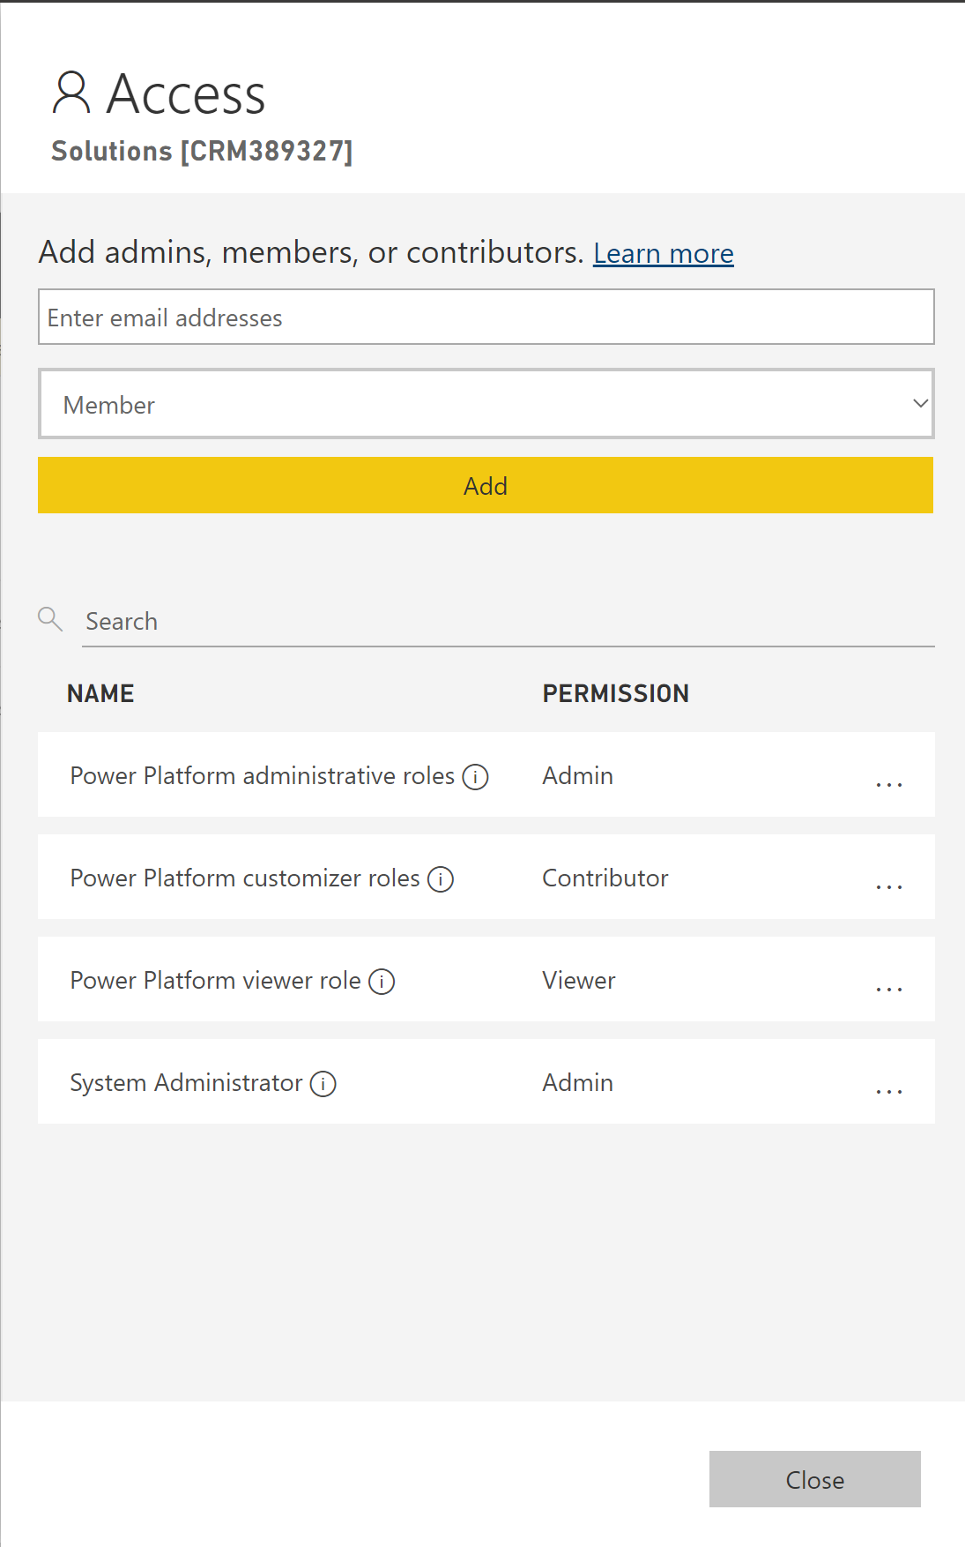
Collaborate and create solutions together
Sync between Dataverse privileges and Power BI workspace permissions:
Power Apps environment administrators and customizers are automatically assigned with permissions on Power BI workspace
Users with org level privileges in Dataverse environment are added as viewer to the workspace
Pre-defined roles can be used to add additional permissions.
Assigning permission directly works independently.
Power Apps
Power BI

Slide 17
Cross Region Compliance
Solution operation (add / import) which move report/dataset metadata between regions.
Cross region may occur if when the source or target workspace in a different region than the Power Platform environment.
Currently checking 3 regions:
source WS
Target WS
PP Env
Tenant
target
source
PBI environment workspace
PBI shared workspace
Report/Dataset
Report/Dataset
Dataverse environment
component
Export

Slide 18
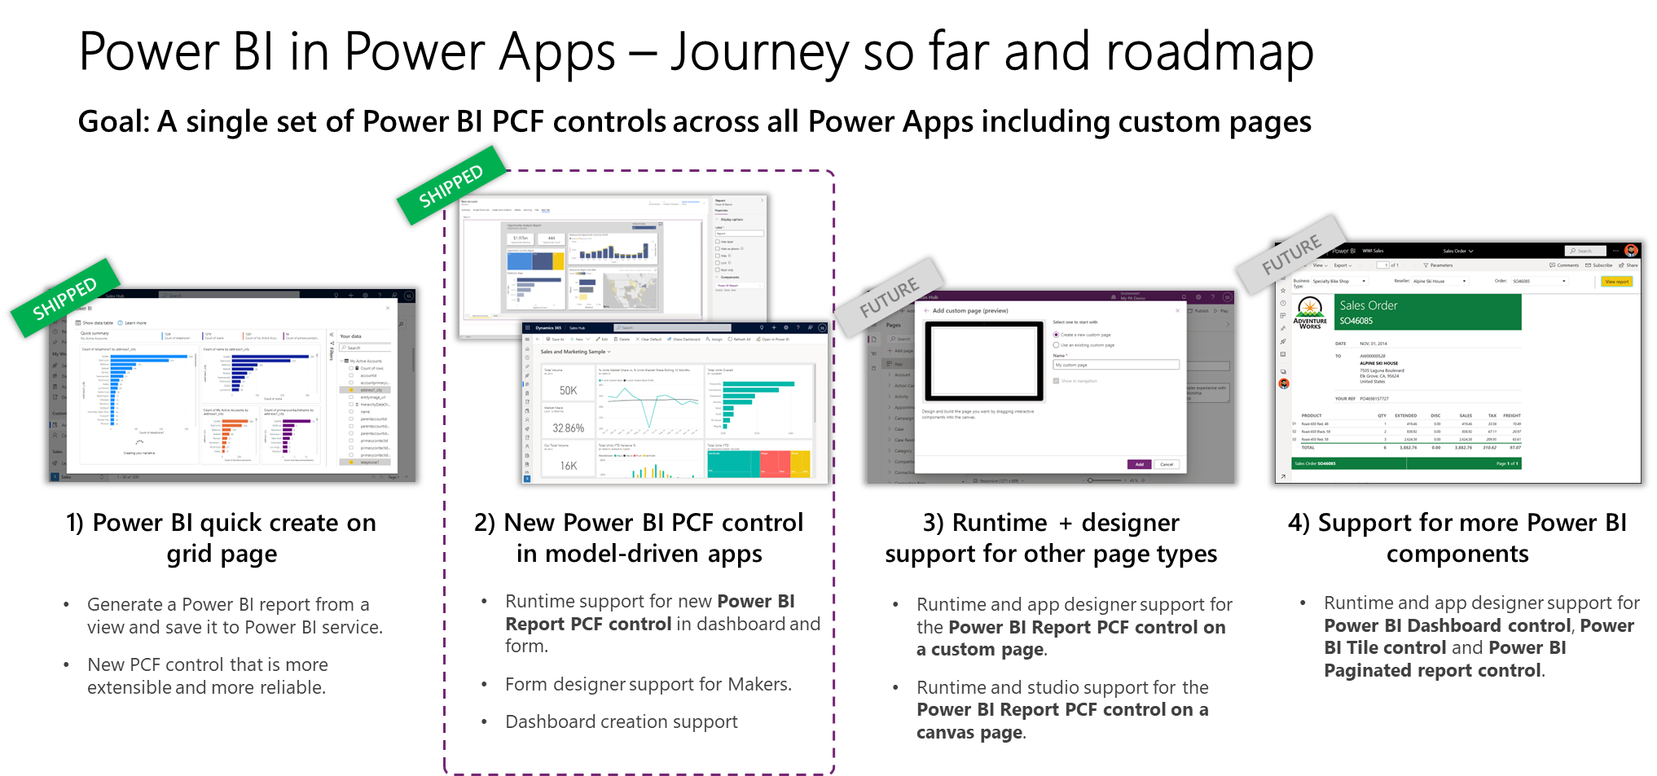
Power Apps and Power BI roadmap
Generally available:
Quick Reports
In progress:
Power BI Solution aware component
Dashboards
Embedded on a form
Future investments:
Tile support
Paginated support
Notes:
Let’s talk about the Power Apps and Power BI Roadmap:
We already shipped the Power BI Quick Create on grid page – quick create is taking all the data that is actively played with and automatically does all the “hard” steps – automatically pull the right field and creating a power bi model behind the scene.
In Progress now is the new Power BI PCF in model driven app – embedding Power BI dashboards to Model-Driven apps and into forms
In the future – a. uploading dashboards to the app designer directly without the need to add the dashboard to the solution first b. adding the Power BI PCF to the custom page and canvas page
In the longer term, supporting more types of Power BI artifacts (paginated report)

Slide 19
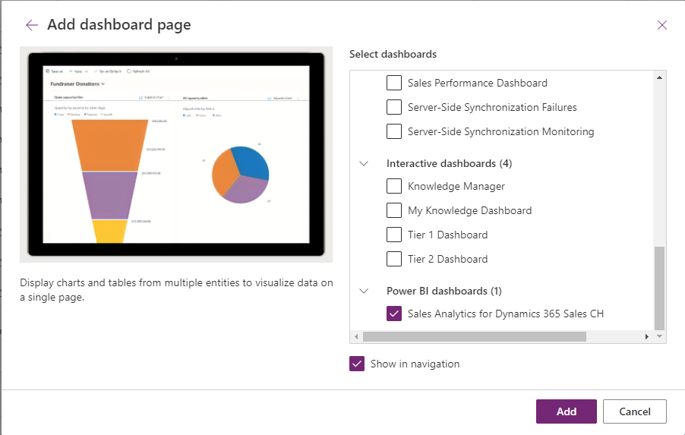
Power BI solution aware component as a dashboard
Quickly and easily add a PBI report to your solution
Add the report as a dashboard in your solution
Add the dashboard to your app
Notes:
In order to use the great capabilities, we just presented, choose report from this environment only. Configure that PCF controll
So until this feature deploying this solution across tenant or environment would break – now it will not.

Slide 20
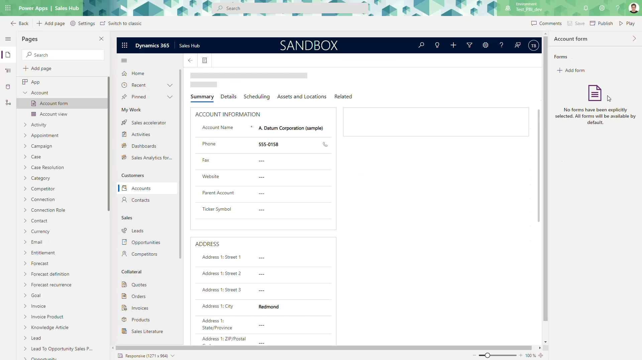
Power BI solution aware component control on a form
After adding the report to your solution (previous slide)
Embedding in form is possible after adding Power BI report to Dataverse
Add the PCF control to your form
Configure the control when adding to the form or after it has been added
Notes:
You will now be able to embed analytics in the context of the user’s form (imagine scenario of sales manager inputting a lead after talking to a potential customer):
All of Power BI filter capabilities can be controlled from the report.
Additionally, you will be able to pass filter from Dataverse to the report to further pass user context
You can change sizes

Slide 21
Roadmap
Near term
ELO (Environment Lifecycle Operations) support
General availability
My workspace support
Cross region governance
Medium term
Quickly create Power BI component (new)
Embedding in Custom page

Slide 22
Get started
Documentation
Blog
Webinar

